Slide 1



BetterCrypto⋅org
Applied Crypto Hardening
David Durvaux
Brussels, 9th June 2014

Slide 2
Why better crypto?

Slide 3


Slide 4
But of course...
It is not only the NSA, who intercepts
Other nations now have a blueprint (thanks to Snowden) in case they did not have the technical skills yet
Criminals now have a blueprint,...
Everyone has!
So, what can we do?

Slide 5
Don’t give them anything for free
It’s your home, your fight!
Notes:
Your fight??

Slide 6
Who (authors of bettercrypto)
Wolfgang Breyha (uni VIE),
David Durvaux (CERT.be),
Tobias Dussa (KIT-CERT),
L. Aaron Kaplan (CERT.at),
Florian Mendel (IAIK/A-Sit)
Christian Mock (coretec),
Daniel Kovacic (A-Trust),
Manuel Koschuch (FH Campus Wien),
Adi Kriegisch (VRVis),
Ramin Sabet (A-Trust),
Aaron Zauner (azet.org),
Pepi Zawodsky (maclemon.at),
And many other contributors!!

Slide 7
Agenda
Introduction to BetterCrypto project
Practical Settings
Testing
Conclusion

Slide 8
BetterCrypto

Slide 9
Why?
Crypto is cryptic
A lot of difficult concepts
A lot of algorithms
A lot of parameters
…
Notes:
Take best from academic and on-field experience and put that together!
Transform into practical settings

Slide 10
The Idea
Really difficult for systems administrators
A “cookbook” can help!
That’s BetterCrypo

Slide 11
That’s not…
A crypto course
A static document

Slide 12
In brief
Community effort to produce best common practices for typical servers
Continuous effort
From diverse areas of expertise: sysadmins, cryptologists, developers, IT security pros
Open Source (CC-BY-SA)
Open to comments / suggestions / improvements

Slide 13
2 parts
First part = configurations
The most important part
Cover as many tools as possible
Second part = theory
Explain and justify choose we made
Transparency

Slide 14
How to use the bettercrypto guide?

Slide 15
BetterCrypto CipherSuite
2 cipher suites
version A
stronger
fewer supported clients
version B
weaker
more “universal”
Notes:
Nothing to do with cipher suite of NSA

Slide 16
Some general thoughts on settings
General
Disable SSL 2.0 (weak algorithms)
Disable SSL 3.0 (BEAST vs IE/XP)
Enable TLS 1.0 or preferably better
Disable TLS-Compression (SSL-CRIME Attack)
Implement HSTS (HTTP Strict Transport Security)
Notes:
From Joe:
I'd probably break TLS 1.0, as well as the earlier stuff

Slide 17
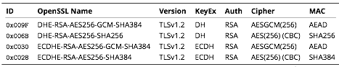
Cipher Suite A
TLS 1.2
Perfect forward secrecy / ephemeral Diffie Hellman
Strong MACs (SHA-2) or
GCM as Authenticated Encryption scheme
Notes:
From Joe:
Might want to clarify that the project's "Suite A" and "Suite B" aren't related to the NSA's "Suite B" specification Do you want to talk about why you don't do ECDSA instead of RSA in ECDHE-RSA-AES256-GCM-SHA384?

Slide 18
CiperSuite B
TLS 1.2, TLS 1.1, TLS 1.0
Allowing SHA-1
Notes:
From Joe:
Motivation for allowing SHA-1? Simple: most certs still rely on it. (see my crypto BCP talk at 57-61) Permitting TLS 1.0 is a tougher "sell" for me. I wouldn't allow it.

Slide 19
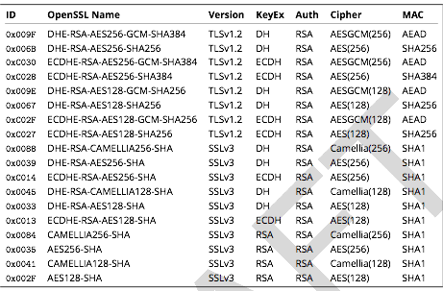
Cipher Suite B
Notes:
From Joe:
Rational for preferring CAMELLIA over AES?
Aaron:
Algorithmic agility argument. It has pros and cons. On the one had, AES is more trusted, on the other hand what if it turns out there is a backdoor there?
Also, be aware to cipher string lengths (c.f., http://rt.openssl.org/Ticket/Display.html?user=guest&pass=guest&id=2771 )

Slide 20
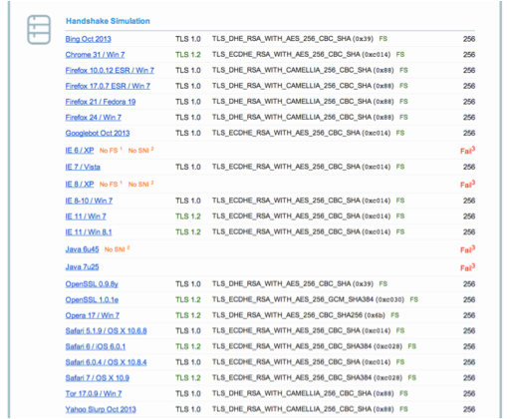
Compatibility (B suite)
Notes:
Balance between compatibliy and strenght
Camellia or AES
https://www.ssllabs.com/ssltest/analyze.html?d=www.ssllabs.com&s=173.203.82.166 (DEMO?)

Slide 21

Practical Settings

Slide 22
Tools covered
Web servers
SSH
Mail Servers
VPNP
GP/GPG
IPMI/ILO
Instant Messaging
RDBMS
Proxy
Kerberos
…
Notes:
From Joe:
Will you be fleshing those out, or are they going to stay the way they currently are? FWIW, expect significant interest around email (SMTP, POP/IMAP, SMTP Submit) and web (e.g., for web email)

Slide 23
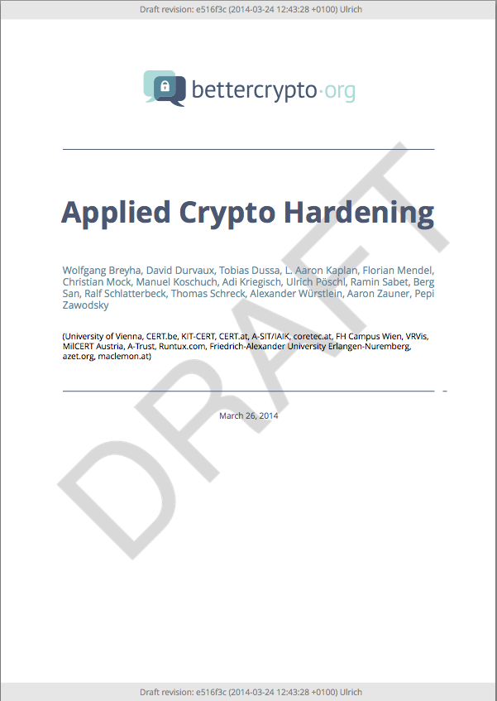
Let’s have a look

Slide 24
Mail Encryption
GPG / PGP – end to end protection
Use public / private crypto to protect your emails
Chain of trust
Independent of the mail client / transport layer
Can be used to verify author and/or protect content
STARTTLS for SMTP – in transit
Notes:
From Joe:
s/PGG/PGP I'd be interested to hear if you believe E2E encryption (e.g., use of PGP or S/MIME) is ultimately the solution Do you also want to talk about how email is actually hop-by-hop, and some hops may be opportunistically encrypted, while others may not be? (and how traffic will be exposed while it transits the intervening nodes?) I've become a fan of Postfix's nomenclature for opportunistic encryption: Postfix nomenclature (http://www.postfix.org/FORWARD_SECRECY_README.html) -- Anonymous (no peer certificate) -- Untrusted (peer cert not signed by trusted CA) -- Trusted (peer cert signed by trusted CA, unverified peer name) -- Verified (peer cert signed by trusted CA, verified peer name; or peer cert with expected public key or cert fingerprint) MITM risk is hard to mitigate, I think... Be sure to cover what happens if opportunistic encryption fails... is something better than nothing? Or is the right answer, "Hard core or nothing?" BTW, terrific article on STARTTLS from Facebook (Mike Adkins, you'll meet him at Brussels): https://www.facebook.com/notes/protect-the-graph/the-current-state-of-smtp-starttls-deployment/1453015901605223

Slide 25
Mail Server
SMTP make use of opportunistic TLS
3 modes for mailservers
Mail Submission Agent (MSA)
Receiving Mail Transmission Agent (MX)
Sending Mail Transmission Agent (SMTP client)
Notes:
Our Guide HAS a section…

Slide 26
Mail Server
Correct DNS configuration without CNAMEs
Enable encryption
NO self-signed certificates

Slide 27
SMTP client mode
Hostname used as HELO must match the PTR RR
Setup a client certificate
Common name or alternate subject name must match the PTR RR
Don‘t touch cipher suite

Slide 28
MSA
Listen on port 587
Enforce SMTP AUTH
No SMTP AUTH on unencrypted connections
(use recommended cipher suites)

Slide 29
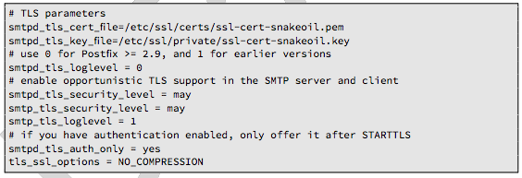
Postfix: MX & SMTP client
In main.cf
Enable opportunistic TLS

Slide 30
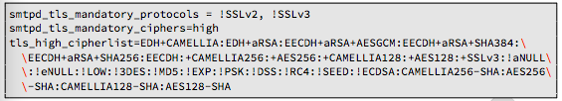
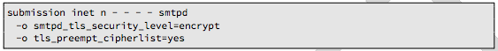
Postfix: MSA
Define ciper suite:
Configure MSA SMTP:

Slide 31
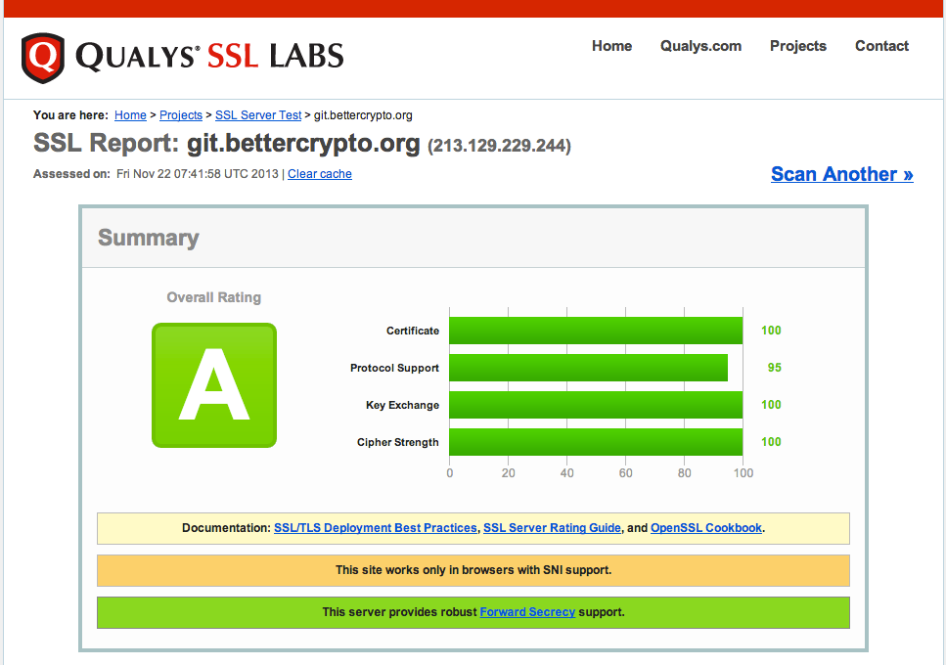
Tools: ssllabs
Notes:
Workshop to SSLLabs…

Slide 32
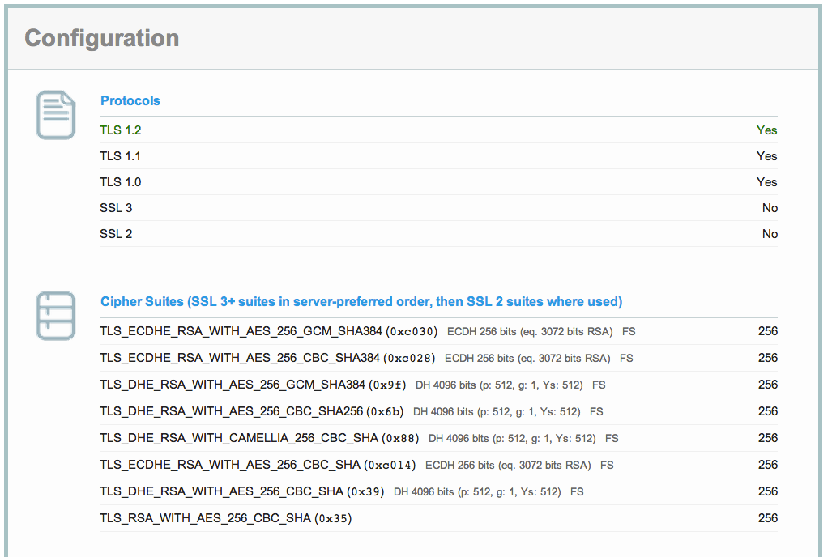
ssllabs (2)

Slide 33
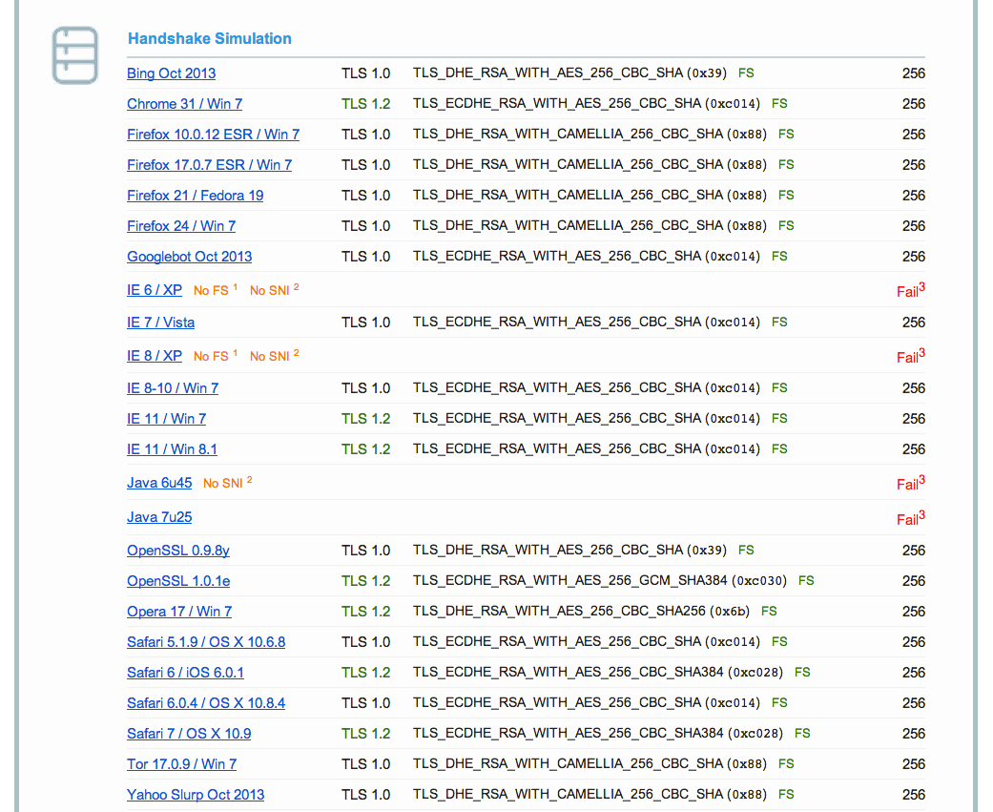
Ssllabs (3)

Slide 34
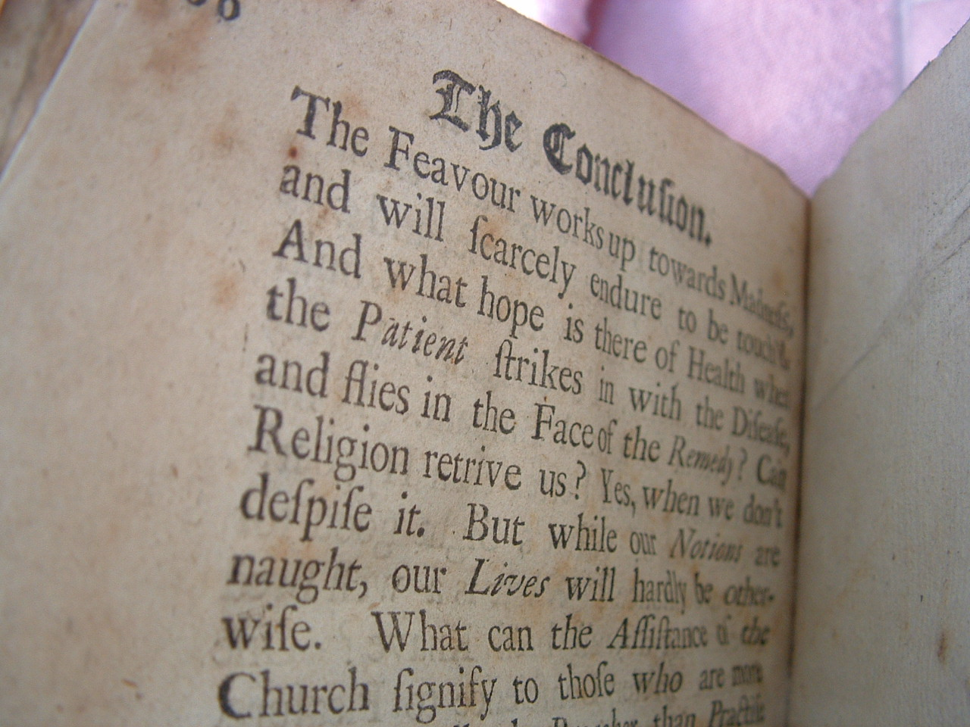
Conclusion

Slide 35
Future ideas
Configuration Generator (online)
Other tools
Other protocols

Slide 36
Current state as of 2014/05/31
Solid basis with Variant (A) and (B)
Public draft was widely presented at the CCC, RIPE meeting, IETF Strint workshop, Linuxdays, ..., M3AAWG
Section „cipher suites“ still a bit messy, needs more work
Need to convert to HTML

Slide 37
How to participate
We need: cryptologists, sysadmins, hackers
Read the document, find bugs
Subscribe to the mailing list
Understand the cipher strings Variant (A) and (B) before proposing some changes
If you add content to a subsection, make a sample config with variant (B)
Git repo is world-readable
We need:
Add content to an subsection from the TODO list → send us diffs
Reviewers!

Slide 38
Thank you!
BetterCrypto.org
https://git.bettercrypto.org/ach-master.git
http://lists.cert.at/cgi-bin/mailman/listinfo/ach
Contact
david@autopsit.org — @ddurvaux

